Slide 1
Data Mining Lab Assignments
Name: Sankhasubhra Mandal
Roll no: 510517063

Slide 2
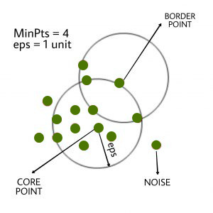
DBSCAN ALGORITHM
DBSCAN algorithm requires two parameters –
eps : It defines the neighborhood around a data point i.e. if the distance between two points is lower or equal to ‘eps’ then they are considered as neighbors. If the eps value is chosen too small then large part of the data will be considered as outliers. If it is chosen very large then the clusters will merge and majority of the data points will be in the same clusters.
MinPts: Minimum number of neighbors (data points) within eps radius. Larger the dataset, the larger value of MinPts must be chosen. As a general rule, the minimum MinPts can be derived from the number of dimensions D in the dataset as, MinPts >= D+1. The minimum value of MinPts must be chosen at least 3.
There are 3 points we can say from the DBSCAN algorithm
1. Core point : The centre is called core point
2. Boundary point : neighbour of core point
3. Noise or Outlier
Steps of DBSCAN algorithm :–
Find all the neighbor points within eps and identify the core points or visited with more than MinPts neighbors.
For each core point if it is not already assigned to a cluster, create a new cluster.
Find recursively all its density connected points and assign them to the same cluster as the core point.
A point a and b are said to be density connected if there exist a point c which has a sufficient number of points in its neighbors and both the points a and b are within the eps distance. This is a chaining process. So, if b is neighbor of c, c is neighbor of d, d is neighbor of e, which in turn is neighbor of a implies that b is neighbor of a.
Iterate through the remaining unvisited points in the dataset. Those points that do not belong to any cluster are noise.
Solution added with the 1st.py file

Slide 3
Datasets :
Results
1.Iris Dataset :
Dataset is : Iris
cluster is same as cluster : 0
Length: 50
cluster is far away as cluster : 1
Length: 95
cluster is wrong as cluster : -1
Length: 5
Dataset is : Wine
cluster is same as cluster : 0
Length: 104
cluster is wrong as cluster : -1
Length: 23
cluster is far away as cluster : 1
Length: 51
Dataset is : Health Diagonistics
cluster is wrong as cluster : -1
Length: 183
cluster is same as cluster : 0
Length: 35
cluster is far away as cluster : 1
Length: 351
Different types of Index vales
Silhoutte Index : 0.7010033614890454
Davies Bouldin Index : 0.3736385210745493
Dunn Index : 0.9091010703643412
Silhoutte Index : 0.055715285990316554
Davies Bouldin Index : 1.177212056872162
Dunn Index : 0.42896679486030503
Silhoutte Index : 0.6893232604583076
Davies Bouldin Index : 0.9515650969948223
Dunn Index : 0.7616463700532302
https://archive.ics.uci.edu/ml/machine-learning-databases/iris/
2.Wine Dataset:
https://archive.ics.uci.edu/ml/machine-learning-databases/wine/
3. Breast Cancer Wisconsin (Diagnostic) Data Set(wdbc):
https://archive.ics.uci.edu/ml/machine-learning-databases/breast-cancer-wisconsin/

Slide 4
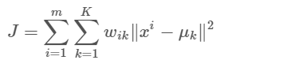
K Means Algorithm
Kmeans algorithm is an iterative algorithm that tries to partition the dataset into K predefined distinct nonoverlapping subgroups (clusters) where each data point belongs to only one group. It tries to make the intra-cluster data points as similar as possible while also keeping the clusters as different (far) as possible. It assigns data points to a cluster such that the sum of the squared distance between the data points and the cluster’s centroid (arithmetic mean of all the data points that belong to that cluster) is at the minimum.
Objective Function:
Algorithm step:
Specify number of clusters K.
Initialize centroids by first shuffling the dataset and then randomly selecting K data points for the centroids without replacement.
Keep iterating until there is no change to the centroids. i.e assignment of data points to clusters isn’t changing.
Compute the sum of the squared distance between data points and all centroids.
Assign each data point to the closest cluster (centroid).
Compute the centroids for the clusters by taking the average of the all data points that belong to each cluster.
Solution added in 2.py file

Slide 5
Datasets :
Results
1.Iris Dataset :
Iris:
Cluster 1
Length: 50
Cluster 0
Length: 48
Cluster 2
Length: 52
BCW:
Cluster 0
Length: 87
Cluster 1
Length: 91
Seeds:
Cluster 0
Length: 110
Cluster 2
Length: 100
Cluster 1
Length: 359
Different types of Index vales
Silhoutte Index : 0.5015860177498301
Davies Bouldin Index : 0.8403435125251728
Dunn Index : 0.585394416716065
Silhoutte Index : 0.32770583468455433
Davies Bouldin Index : 1.5259965836052092
Dunn Index : 0.6564065611490802
Silhoutte Index : 0.23142854916196823
Davies Bouldin Index : 1.5293883767807952
Dunn Index : 0.1301201123721641
https://archive.ics.uci.edu/ml/machine-learning-databases/iris/
2.Wine Dataset:
https://archive.ics.uci.edu/ml/machine-learning-databases/wine/
3. Breast Cancer Wisconsin (Diagnostic) Data Set(wdbc):
https://archive.ics.uci.edu/ml/machine-learning-databases/breast-cancer-wisconsin/

Slide 6
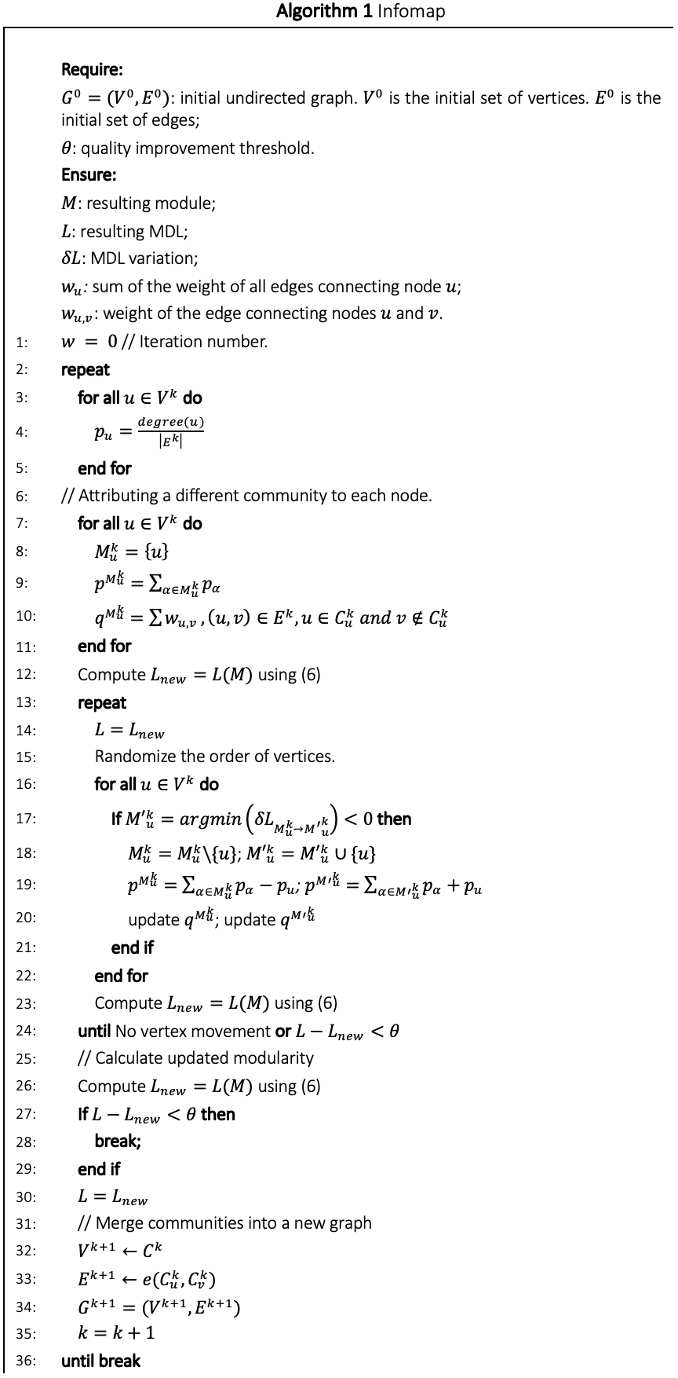
Infomap
Infomap is a graph based clustering algorithm where each data point can be treated as a node with edges connecting pairs of them. Weight of an edge corresponds to the euclidean distance between them.
To implement it, first, an average value of edge weights is determined and all edges with weights less than that are dropped. The final set of edges (in a .gml file) is given as input to igraph’s community_infomap.
Pseudo code of Infomap
Solution added in 3.py file

Slide 7
Datasets :
Datasets :
1.Cumulative Dataset :
1 :
https://github.com/gephi/gephi/wiki/Datasets
2 Infection Dataset:
2.
https://github.com/gephi/gephi/wiki/Datasets
3. Breast Cancer Wisconsin (Diagnostic) Data Set(wdbc):
3. Breast Cancer Wisconsin (Diagnostic) Data Set(wdbc):
https://drive.google.com/drive/u/0/folders/1f26mBwAGRDr2Dt8YNHwF2F1u4ojxgX4l
https://drive.google.com/drive/u/0/folders/1f26mBwAGRDr2Dt8YNHwF2F1u4ojxgX4l
https://drive.google.com/drive/u/0/folders/1f26mBwAGRDr2Dt8YNHwF2F1u4ojxgX4l

Slide 8
Results
Cluster 0: Size-> 85
Cluster 1: Size-> 63
Cluster 2: Size-> 1
Silhouette Index: 0.4773642981457864
Davies Bouldin Index: 0.532792716354438
Dunn Index: 0.48737848665548264
Cluster 0: Size-> 470
Cluster 1: Size-> 205
Cluster 2: Size-> 7
Cluster 3: Size-> 1
Silhouette Index: 0.3982225201808078
Davies Bouldin Index: 1.0674979378756475
Dunn Index: 0.40261282759404193
Cluster 0: Size-> 131
Cluster 1: Size-> 47
Silhouette Index: 0.6571861139335164
Davies Bouldin Index: 0.4564769176170643
Dunn Index: 0.8578590641966346

Slide 9



Silhouette Index:
Silhouette analysis refers to a method of interpretation and validation of consistency within clusters of data. The silhouette value is a measure of how similar an object is to its own cluster (cohesion) compared to other clusters (separation)
The Silhouette Coefficient is calculated using the mean intra-cluster distance (a) and the mean nearest-cluster distance (b) for each sample. The Silhouette Coefficient is defined as –
S(i) = ( b(i) – a(i) ) / ( max { ( a(i), b(i) ) }
Here, a(i) is the average dissimilarity of ith object to all other objects in the same cluster and b(i) is the average dissimilarity of ith object with all objects in the closest cluster
S(i) will lie between [-1, 1] : –
If silhouette value is close to 1, sample is well-clustered and already assigned to a very appropriate cluster.
If silhouette value is about to 0, sample could be assign to another cluster closest to it and the sample lies equally far away from both the clusters. That means it indicates overlapping clusters
If silhouette value is close to –1, sample is misclassified and is merely placed somewhere in between the clusters.
Dunn Index :
The aim of this Dunn index to identify sets of clusters that are compact, with a small variance between members of the cluster, and well separated, where the means of different clusters are sufficiently far apart, as compared to the within cluster variance.Higher the Dunn index value, better is the clustering. The number of clusters that maximizes Dunn index is taken as the optimal number of clusters k
DaviesBouldin index:
How well the clustering has been done is made using quantities and features inherent to the dataset.Lower the DB index value, better is the clustering.

Slide 10
Algorithms of Assignment 1
Results of clusters
Haberman:
Cluster 0
Length: 194
Cluster 1
Length: 112
Wine:
Cluster 0
Length: 117
Cluster 2
Length: 23
Cluster 1
Length: 38
Seeds:
Cluster 0
Length: 58
Cluster 2
Length: 79
Cluster 1
Length: 73
Different types of Index vales
Silhoutte Index : 0.0505217895651872
Davies Bouldin Index : 1.3766903915296373
Dunn Index : 0.08414834930621495
Silhoutte Index : -0.1538486994459234
Davies Bouldin Index : 1.7434527174191399
Dunn Index : 0.037793636450330785
Silhoutte Index : 0.370871300745064
Davies Bouldin Index : 1.2565045699438082
Dunn Index : 0.37527079531253027
Datasets:
1.Haberman Dataset:
https://drive.google.com/drive/folders/1f26mBwAGRDr2Dt8YNHwF2F1u4ojxgX4l
2.wine Dataset
https://archive.ics.uci.edu/ml/machine-learning-databases/wine/
3.seeds_dataset
https://drive.google.com/drive/folders/1f26mBwAGRDr2Dt8YNHwF2F1u4ojxgX4l
Solution in Algo1.py file

Slide 11
CLASSIFICATION
For each of the classification algorithms, for each dataset, a 10 fold cross validation is done wherein the dataset is divided into 10 parts out of which one (1) is considered for testing and the rest for training. The performance is analysed considering each of those 10 parts once for validation/testing.
For each of the 10 iterations, the performance metrics are calculated (from confusion matrix). Average of all those are considered in the end.
Also, ROC (Receiver Operating Characteristic) curve is drawn for each dataset for all classifiers. Area Under Curve (AUC) is mentioned for them as well. An AUC of 1 indicates good separability and that of 0 indicates the worst. A value of 0.5 indicates no class separation capacity of the model.
Datasets:
Haberman.csv
https://drive.google.com/drive/folders/1f26mBwAGRDr2Dt8YNHwF2F1u4ojxgX4l
Wine.csv
https://drive.google.com/drive/folders/1f26mBwAGRDr2Dt8YNHwF2F1u4ojxgX4l
Bcw.csv
https://drive.google.com/drive/folders/1f26mBwAGRDr2Dt8YNHwF2F1u4ojxgX4l

Slide 12
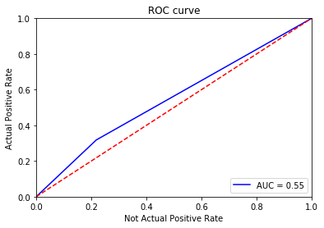
Decision Tree
Decision tree algorithm falls under the category of supervised learning. Decision tree uses the tree representation to solve the problem in which each leaf node corresponds to a class label and attributes are represented on the internal node of the tree.
Pseudocode :
Find the best attribute and place it on the root node of the tree.
Now, split the training set of the dataset into subsets. While making the subset make sure that each subset of training dataset should have the same value for an attribute.
Find leaf nodes in all branches by repeating 1 and 2 on each subset.
Results
1st Dataset(Haberman.csv):--->
ROC curve
Average value of performance metrics:
Accuracy: 0.6493548387096774
Specificity: 0.0625
Sensitivity: 0.34214285714285714
Precision: 0.01818181818181818
F-measure: 0.523165268641112
Classification result (Count of “Predicted class labels” and “Actual class labels”):
Prediction: 222 84
Class label: 225 81

Slide 13
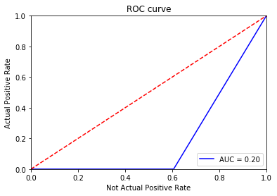
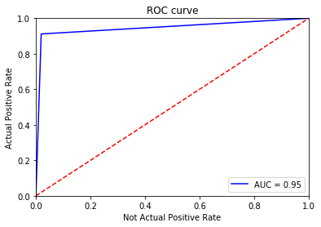
2nd Dataset(wine.csv):--->
ROC curve
Average value of performance metrics:
Accuracy: 0.9218954248366014
Specificity: 0.08571428571428572
Sensitivity: 0.9875
Precision: 0.0875
F-measure: 1.5159654721421352
Classification result (Count of “Predicted class labels” and “Actual class labels”):
Prediction: 56 122
Class label: 59 119
3rd Dataset(bcw.csv):--->
ROC curve
Average value of performance metrics:
Accuracy: 0.9546035805626598
Specificity: 0.1
Sensitivity: 0.91808437192916
Precision: 0.1
F-measure: 1.489799595999371
Classification result (Count of “Predicted class labels” and “Actual class labels”):
Prediction: 451 232
Class label: 444 239

Slide 14
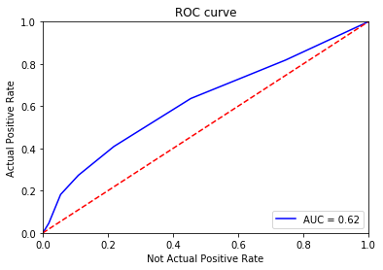
K-NN Algorithm
K-nearest neighbors (KNN) algorithm uses ‘feature similarity’ to predict the values of new datapoints which further means that the new data point will be assigned a value based on how closely it matches the points in the training set.
Algorithm:
Step 1 − For implementing any algorithm, we need dataset. So during the first step of KNN, we must load the training as well as test data.
Step 2 − Next, we need to choose the value of K i.e. the nearest data points. K can be any integer.
Step 3 − For each point in the test data do the following −
3.1 − Calculate the distance between test data and each row of training data with the help of any of the method namely: Euclidean, Manhattan or Hamming distance. The most commonly used method to calculate distance is Euclidean.
3.2 − Now, based on the distance value, sort them in ascending order.
3.3 − Next, it will choose the top K rows from the sorted array.
3.4 − Now, it will assign a class to the test point based on most frequent class of these rows.
Step 4 − End
1st Dataset(wine.csv):--->
ROC curve
Average value of performance metrics:
Accuracy: 0.7227956989247312
Specificity: 0.09523809523809523
Sensitivity: 0.11578144078144077
Precision: 0.05
F-measure: 0.39491613511850526
Classification result (Count of “Predicted class labels” and “Actual class labels”):
Prediction: 280 26
Class label: 225 81

Slide 15
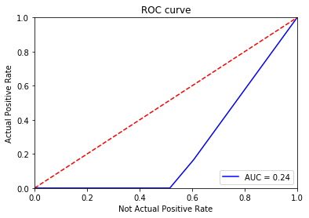
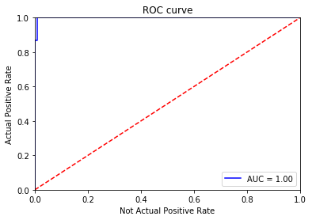
2nd Dataset(wine.csv):--->
2nd Dataset(wine.csv):--->
ROC curve
ROC curve
Average value of performance metrics:
Average value of performance metrics:
Accuracy: 0.9493464052287583
Specificity: 0.1
Sensitivity: 0.9214285714285715
Precision: 0.1
F-measure: 1.5842893082894538
Classification result (Count of “Predicted class labels” and “Actual class labels”):
Classification result (Count of “Predicted class labels” and “Actual class labels”):
Prediction: 65 113
Class label: 59 119
ROC curve
3rd Dataset(bcw.csv):--->
3rd Dataset(bcw.csv):--->
Average value of performance metrics:
Average value of performance metrics:
Accuracy: 0.9678175618073317
Specificity: 0.09743589743589744
Sensitivity: 0.9527828118907579
Precision: 0.09655172413793103
F-measure: 1.5213300278207036
Classification result (Count of “Predicted class labels” and “Actual class labels”):
Classification result (Count of “Predicted class labels” and “Actual class labels”):
Prediction: 446 237
Class label: 444 239

Slide 16
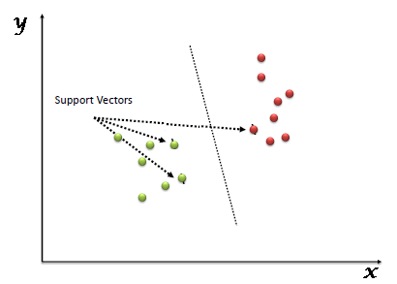
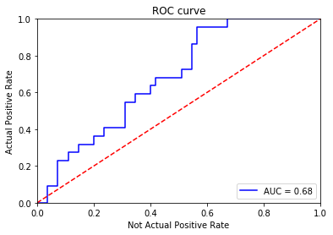
SVM Algorithm
“Support Vector Machine” (SVM) is a supervised machine learning algorithm which can be used for both classification or regression challenges. However, it is mostly used in classification problems. In the SVM algorithm, we plot each data item as a point in n-dimensional space (where n is number of features you have) with the value of each feature being the value of a particular coordinate. Then, we perform classification by finding the hyper-plane that differentiates the two classes very well (look at the below snapshot).
Support Vectors are simply the co-ordinates of individual observation. The SVM classifier is a frontier which best segregates the two classes (hyper-plane/ line).
1st Dataset(wine.csv):--->
Average value of performance metrics:
Accuracy: 0.7289247311827958
Specificity: 0.09166666666666666
Sensitivity: 0.16703102453102453
Precision: 0.03333333333333333
F-measure: 0.5439474901097477
ROC curve
Classification result (Count of “Predicted class labels” and “Actual class labels”):
Prediction: 278 28
Class label: 225 81

Slide 17
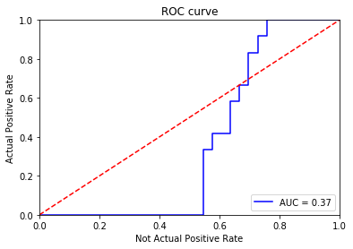
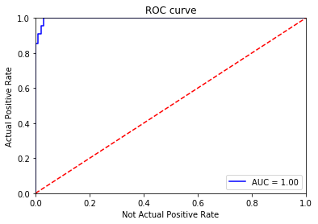
2nd Dataset(wine.csv):--->
2nd Dataset(wine.csv):--->
ROC curve
ROC curve
Average value of performance metrics:
Average value of performance metrics:
Accuracy: 0.9830065359477125
Specificity: 0.1
Sensitivity: 1.0
Precision: 0.1
F-measure: 1.5778222838335199
Classification result (Count of “Predicted class labels” and “Actual class labels”):
Classification result (Count of “Predicted class labels” and “Actual class labels”):
Prediction: 58 120
Class label: 59 119
ROC curve
3rd Dataset(bcw.csv):--->
3rd Dataset(bcw.csv):--->
Average value of performance metrics:
Average value of performance metrics:
Accuracy: 0.9663469735720375
Specificity: 0.09302325581395349
Sensitivity: 0.974092833092833
Precision: 0.08928571428571429
F-measure: 1.4984429758963562
Classification result (Count of “Predicted class labels” and “Actual class labels”):
Classification result (Count of “Predicted class labels” and “Actual class labels”):
Prediction: 435 248
Class label: 444 239

Slide 18
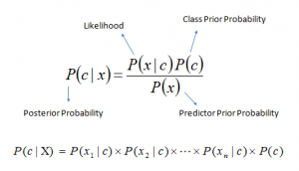
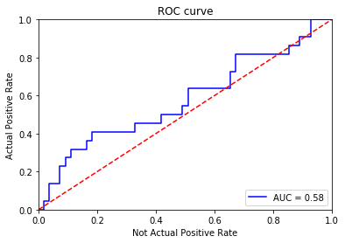
NBC Algorithm
It is a classification technique based on Bayes’ Theorem with an assumption of independence among predictors. In simple terms, a Naive Bayes classifier assumes that the presence of a particular feature in a class is unrelated to the presence of any other feature.
Where,
P(c|x) is the posterior probability of class (c, target) given predictor (x, attributes).
P(c) is the prior probability of class.
P(x|c) is the likelihood which is the probability of predictor given class.
P(x) is the prior probability of predictor.
1st Dataset(wine.csv):--->
ROC curve
Average value of performance metrics:
Accuracy: 0.7422580645161291
Specificity: 0.08636363636363636
Sensitivity: 0.19184065934065933
Precision: 0.05
F-measure: 0.5905028155038459
Classification result (Count of “Predicted class labels” and “Actual class labels”):
Prediction: 278 28
Class label: 225 81

Slide 19
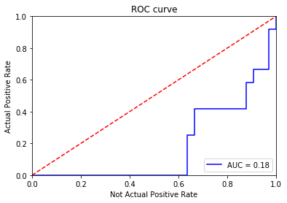
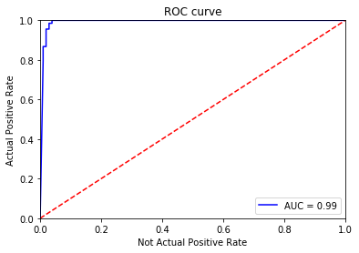
2nd Dataset(wine.csv):--->
2nd Dataset(wine.csv):--->
ROC curve
Average value of performance metrics:
Average value of performance metrics:
Accuracy: 0.9826797385620916
Specificity: 0.1
Sensitivity: 1.0
Precision: 0.1
F-measure: 1.551226217332857
Classification result (Count of “Predicted class labels” and “Actual class labels”):
Classification result (Count of “Predicted class labels” and “Actual class labels”):
Prediction: 57 121
Class label: 59 119
ROC curve
3rd Dataset(bcw.csv):--->
3rd Dataset(bcw.csv):--->
Average value of performance metrics:
Average value of performance metrics:
Accuracy: 0.9604433077578858
Specificity: 0.09743589743589744
Sensitivity: 0.9701584435055199
Precision: 0.09655172413793103
F-measure: 1.491106759770064
Classification result (Count of “Predicted class labels” and “Actual class labels”):
Classification result (Count of “Predicted class labels” and “Actual class labels”):
Prediction: 431 252
Class label: 444 239

Slide 20
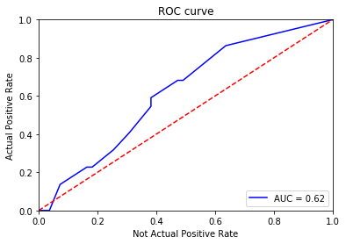
Bagging classification Algorithms
A Bagging classifier is an ensemble meta-estimator that fits base classifiers each on random subsets of the original dataset and then aggregate their individual predictions (either by voting or by averaging) to form a final prediction. Such a meta-estimator can typically be used as a way to reduce the variance of a black-box estimator (e.g., a decision tree), by introducing randomization into its construction procedure and then making an ensemble out of it.
Bagging reduces overfitting (variance) by averaging or voting, however, this leads to an increase in bias, which is compensated by the reduction in variance though.
Algorithm
Classifier generation:
Let N be the size of the training set.
for each of t iterations:
sample N instances with replacement from the original training set.
apply the learning algorithm to the sample.
store the resulting classifier.
Classification:
for each of the t classifiers:
predict class of instance using classifier.
return class that was predicted most often.
ROC curve
1st Dataset(wine.csv):--->
Average value of performance metrics:
Accuracy: 0.6732258064516129
Specificity: 0.07619047619047618
Sensitivity: 0.2537373737373737
Precision: 0.016666666666666666
F-measure: 0.5744137664127995
Classification result (Count of “Predicted class labels” and “Actual class labels”):
Prediction: 249 57
Class label: 225 81

Slide 21
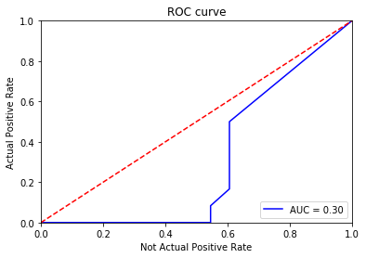
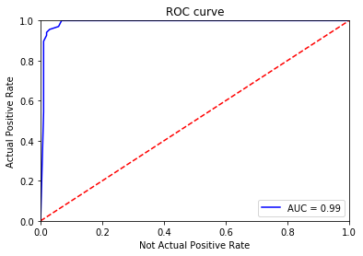
2nd Dataset(wine.csv):--->
2nd Dataset(wine.csv):--->
ROC curve
Average value of performance metrics:
Average value of performance metrics:
Accuracy: 0.9607843137254903
Specificity: 0.08333333333333334
Sensitivity: 0.9732142857142858
Precision: 0.08888888888888888
F-measure: 1.5365241612426193
Classification result (Count of “Predicted class labels” and “Actual class labels”):
Classification result (Count of “Predicted class labels” and “Actual class labels”):
Prediction: 58 120
Class label: 59 119
ROC curve
3rd Dataset(bcw.csv):--->
3rd Dataset(bcw.csv):--->
Average value of performance metrics:
Average value of performance metrics:
Accuracy: 0.9560315430520034
Specificity: 0.09795918367346938
Sensitivity: 0.9261434727060468
Precision: 0.09473684210526315
F-measure: 1.510908274274997
Classification result (Count of “Predicted class labels” and “Actual class labels”):
Classification result (Count of “Predicted class labels” and “Actual class labels”):
Prediction: 450 233
Class label: 444 239

